Slide 1



Advanced data modeling
Sistem Basis Data
Rizka Wakhidatus Sholikah

Slide 2



Outline
Extended Entity Relational Model
Entity Clustering
Selecting Primary Keys
www.its.ac.id
INSTITUT TEKNOLOGI SEPULUH NOPEMBER, Surabaya - Indonesia

Slide 3

EERM
EERM (Extended entity Relationship Model)
Adding more semantic constructs to the original ERM
Cover increasing complexity in application
The diagram that use in EERM is called EERD (extended Entity Relationship Diagram)
www.its.ac.id
INSTITUT TEKNOLOGI SEPULUH NOPEMBER, Surabaya - Indonesia

Slide 4
Entity Supertypes and Subtypes
Entity supertypes is generic entity type that is related to one or more entity subtypes
Entity supertypes contain common characteristics
Entity subtypes contain their own unique characterictics
Example:
In a company, Entity Employee is supertypes of entity Pilot, Mechanic, Accountant
Why?
www.its.ac.id
INSTITUT TEKNOLOGI SEPULUH NOPEMBER, Surabaya - Indonesia

Slide 5
Entity Supertypes and Subtypes cont.
Each types of employee (manager, programmer, etc.) has their own characteristic
If all the characteristics were store in Employee table → sparse table (a lot of NULL value)
www.its.ac.id
INSTITUT TEKNOLOGI SEPULUH NOPEMBER, Surabaya - Indonesia

Slide 6
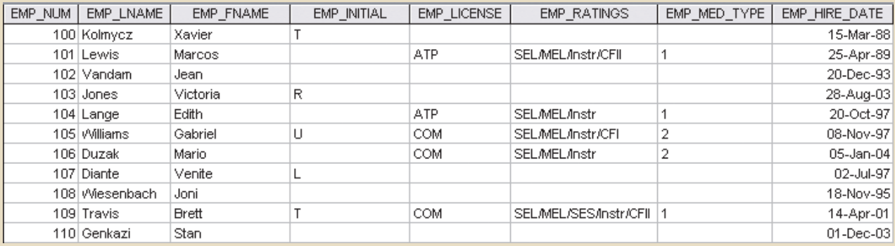
Entity Supertypes and Subtypes cont.
www.its.ac.id
INSTITUT TEKNOLOGI SEPULUH NOPEMBER, Surabaya - Indonesia

Slide 7
Entity Supertypes and Subtypes cont.
Two criteria to help designer determine when to use subtypes and supertypes:
There must be different, identifiable kinds or types of the entity in the user’s environment
The different kinds or types of instances should each have one or more attributes that are unique to that kind or type of instance.
Example:
In a company, there are Pilot, Mechanic, Accountant, and Clerk
Pilot, Mechanic, and Accountant can be subtype of entity Employee because they contain unique attribute
Suppose Clerk does not contain unique attribute, the entity Clerk cannot be acceptable as subtype of entity Employee
www.its.ac.id
INSTITUT TEKNOLOGI SEPULUH NOPEMBER, Surabaya - Indonesia

Slide 8
Specialization hierarchy
A hierarchy based on the top-down process
Depicts the arrangement of higher-level entity supertypes (parent entities) and lower-level entity subtypes (child entities)
Specialization is based on grouping unique characteristics and relationships of the subtypes
The specialization hierarchy → 1..1 relationship
The relationship within specialization hierarchy is called “is-a” relationship
www.its.ac.id
INSTITUT TEKNOLOGI SEPULUH NOPEMBER, Surabaya - Indonesia

Slide 9
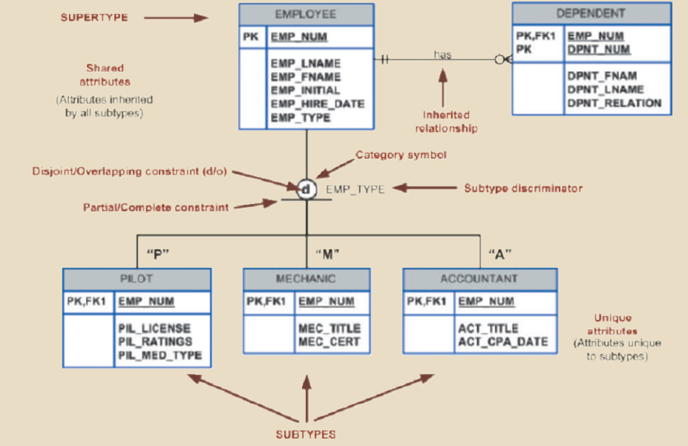
Specialization hierarchy cont.
www.its.ac.id
INSTITUT TEKNOLOGI SEPULUH NOPEMBER, Surabaya - Indonesia

Slide 10
Specialization hierarchy cont.
Every subtype can have only one supertype to which it is directly related
A specialization hierarchy can have many levels of supertype or subtype relationships
www.its.ac.id
INSTITUT TEKNOLOGI SEPULUH NOPEMBER, Surabaya - Indonesia

Slide 11
Inheritance
In the EERD, the property that enables an entity subtype to inherit the attributes and relationships of the entity supertype
A lower-level subtype inherits all of the attributes and relationships from all of its upper-level supertypes
Subtypes still can have their own relationship
www.its.ac.id
INSTITUT TEKNOLOGI SEPULUH NOPEMBER, Surabaya - Indonesia

Slide 12
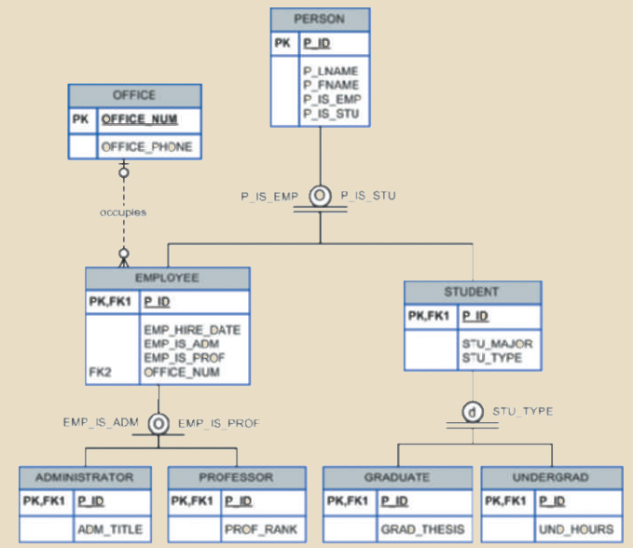
Inheritance cont.
www.its.ac.id
INSTITUT TEKNOLOGI SEPULUH NOPEMBER, Surabaya - Indonesia

Slide 13
Subtype discriminator
The attribute in the supertype entity that determines to which subtype the supertype occurrence is related
www.its.ac.id
INSTITUT TEKNOLOGI SEPULUH NOPEMBER, Surabaya - Indonesia

Slide 14
Disjoint constraints
Disjoint subtype also known as non-overlapping subtypes
Subtypes that contain a unique subset of the supertype entity set
Each entity instance of the supertype can appear in only one of the subtypes
If the business rules state that an employee cannot belong more than one subtype at a time, the disjoint subtype can be used
Use symbol d inside the category shape
www.its.ac.id
INSTITUT TEKNOLOGI SEPULUH NOPEMBER, Surabaya - Indonesia

Slide 15
Overlapping constraints
If the business rules state that an employee can have multiple classification at a time
We can use overlapping subtypes
Overlapping subtypes are subtypes that contain nonunique subsets of the supertype entity set
Use symbol o inside the category shape
The implementation of overlapping subtypes requires the use of one discriminator attribute for each subtype
www.its.ac.id
INSTITUT TEKNOLOGI SEPULUH NOPEMBER, Surabaya - Indonesia

Slide 16
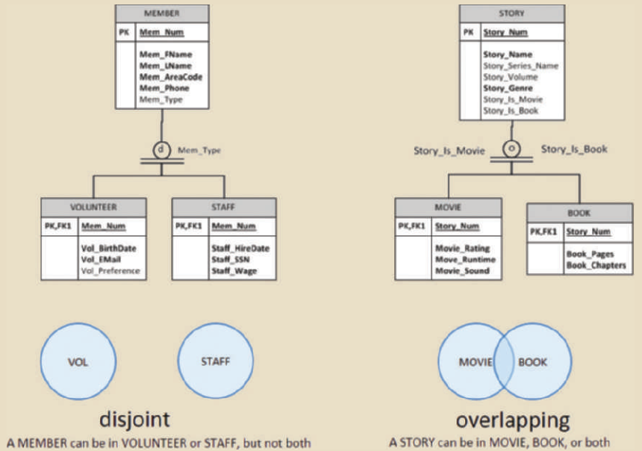
Example
www.its.ac.id
INSTITUT TEKNOLOGI SEPULUH NOPEMBER, Surabaya - Indonesia

Slide 17
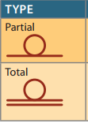
Completeness constraint
The completeness constraint specifies whether each entity supertype occurrence must also be a member of at least one subtype
The completeness constraint can be partial or total
The partial completeness means that not every supertype occurrence is a member of a subtype
Some supertype occurrences may not be members of any subtype
Total completeness means that every supertype occurrence must be a member of at least one subtype
The symbol in ERD:
A single horizontal line under the circle represents a partial completeness constraint
A double horizontal line under the circle represents a total completeness constraint
www.its.ac.id
INSTITUT TEKNOLOGI SEPULUH NOPEMBER, Surabaya - Indonesia

Slide 18
Specialization and generalization
Specialization is the top-down process of identifying lower-level, more specific entity subtypes from a higher-level entity supertype
Generalization is the bottom-up process of identifying a higher-level, more generic entity supertype from lower-level entity subtypes
www.its.ac.id
INSTITUT TEKNOLOGI SEPULUH NOPEMBER, Surabaya - Indonesia

Slide 19
Entity Clustering
An entity cluster is a “virtual” entity type used to represent multiple entities and relationships in the ERD
Formed by combining multiple interrelated entities into a single, abstract entity object
Why?
Because sometimes the application contains a lot of entities and relations that unreadable
Minimize the number of entity shown in ERD
www.its.ac.id
INSTITUT TEKNOLOGI SEPULUH NOPEMBER, Surabaya - Indonesia

Slide 20
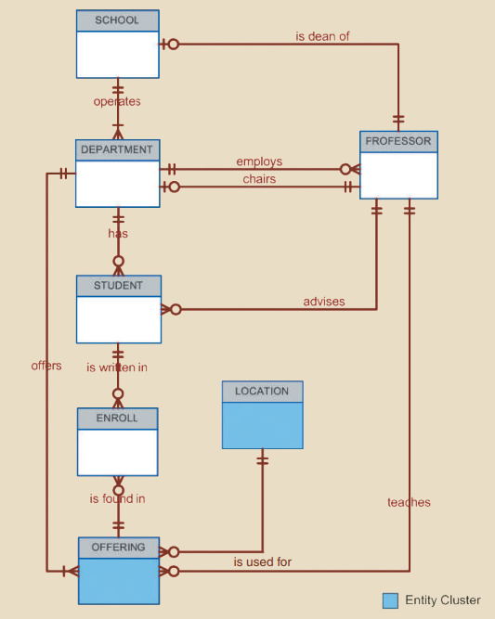
Entity Clustering cont.
When using entity cluster, the general rule is to avoid the display of attributes
www.its.ac.id
INSTITUT TEKNOLOGI SEPULUH NOPEMBER, Surabaya - Indonesia

Slide 21
Natural keys
Primary keys uniquely identifies each entity instance
A natural keys is a real-world, generally accepted identifier used to distinguish real-world objects
www.its.ac.id
INSTITUT TEKNOLOGI SEPULUH NOPEMBER, Surabaya - Indonesia

Slide 22
When to use composite primary key?
In fact, composite primary keys are particularly useful in two cases:
As identifiers of composite entities, in which each primary key combination is allowed only once in the M:N relationship
As identifiers of weak entities, in which the weak entity has a strong identifying relationship with the parent entity
www.its.ac.id
INSTITUT TEKNOLOGI SEPULUH NOPEMBER, Surabaya - Indonesia

Slide 23
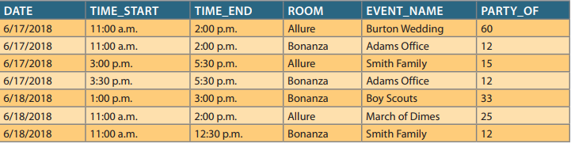
Surrogate primary keys
A system-assigned primary key, generally numeric and auto-incremented
www.its.ac.id
INSTITUT TEKNOLOGI SEPULUH NOPEMBER, Surabaya - Indonesia

Slide 24
Assignment 1
Create a group of 2-3
Choose one of the case studies to solve
Case 1: case no. 8 chapter 5*
Case 2: case no. 9 chapter 5*
Case 3: case no. 10 chapter 5*
Create a complete ERD using crow’s foot model
Use specialization hierarchy if needed
* Carlos M. Coronel - Database Systems_ Design, Implementation, & Management-Cengage Learning (2018)
www.its.ac.id
INSTITUT TEKNOLOGI SEPULUH NOPEMBER, Surabaya - Indonesia

Slide 25
Thank you

